Slide 1
Welcome to CWA!
Board of Directors Orientation Webinar
February 7, 2014

Slide 2
We’ll Talk About…
Brief Introduction to the Association
Your Important Governance Role
Keeping Up with CWA

Slide 3
Your Online Board Resources
Go to www.calwic.org
Click on MEMBER LOGIN (lower right corner)
Username = calwic
Password = gocwa! (with the !)
Go to Board of Directors Page
Annual Meeting/Communications Log
Toolkit

Slide 4
What is CWA?
A non-profit 501 (c ) (3) organization: tax-exempt—see Toolkit
Articles of Incorporation—see Toolkit
Financial audit and tax information (Form 990)—see Toolkit
Guidestar: Silver-level Participant—Donation button

Slide 5
Brief History of CWA
WIC Crisis Coalition formed in 1986 -- Met in Church Basement
1991: WIC Evaluation/Reforms by Gov. Pete Wilson
1992-2003: Phyllis Bramson hired as WIC Director
1992: CWA incorporates and opens office
1992-1999: Kathy Ries was Executive Director
2000: Laurie True hired as E.D.
2003-2011: Linnea Sallack hired as WIC Director
2012-present: WIC in crisis again

Slide 6
Non-Profit Board Responsibilities
Self-Governance
Policy & Program Guidance
Financial & Legal Oversight
Hiring & Supervision of the Executive Director

Slide 7
Self-Governance: CWA is YOUR Association!
CWA By-Laws: How You Govern Yourselves (in Toolkit)
Job Descriptions for each Board Member (in Toolkit)
Needs Periodic Review and Updating

Slide 8
Policy & Program Guidance
A Board Should Review and approve:
Org chart and HR Manual
Audit and Tax Reporting
Workplans & Annual Budgets
Sponsored or supported legislation
Positions on administrative advocacy
Major Grants and Contracts
And…ask a lot of questions!

Slide 9
Guidance vs. Micromanagment
DO:
Set overall legislative policy platform.
Approve HR manual.
Volunteer for conference planning committee.
Read and approve annual audit.
DON’T:
Write amendments to bills.
Approve vacation leaves for staff.
Choose t-shirt colors.
Approve invoice payment for telephone bill.
Set Policy
Execute Policy

Slide 10
Financial & Legal Oversight Goals
Protect all our assets
Ensure legal and ethical income & resource management
Ensure adherence to state & federal laws

Slide 11
Financial & Legal Oversight
Treasurer gets Monthly Fiscal Reports
Board Reviews and Accepts Annual Audit
An examination of the financial records, accounts, business transactions, accounting practices, and internal controls of a charitable nonprofit by an "independent" auditor.
Board ensures accurate state/federal tax filings
Board reviews and approves personnel policies

Slide 12
Financial & Legal Oversight
Board has legal and fiduciary responsibility for “reasonable oversight and objectivity”
Board Liability Insurance
-What is it? Do we have it?
Board Self-Evaluation is Important!
-Using Checklists for Internal Oversight
-Periodic Review of Overall Governance

Slide 13
Oversight of Executive Director
You are the Boss!
Hiring and Firing
Annual Evaluation and Pay
Supervision & Support

Slide 14
Keeping Up with CWA
Read the Flash, Minutes, and all your E-Mails
Share WIC Watch with your Staff
Attend & Contribute to all Board Meetings
Ask a lot of Questions
Believe in and promote CWA to Community!

Slide 15
Support CWA Mission & Values
Broad view: We’re more than a trade organization!
Objectivity: What is best for the greater good of WIC?
Bravery: Speak up for those who can’t. Advocate on your lunch hour if you have to!
Stay Informed. You are a spokesperson now!

Slide 16
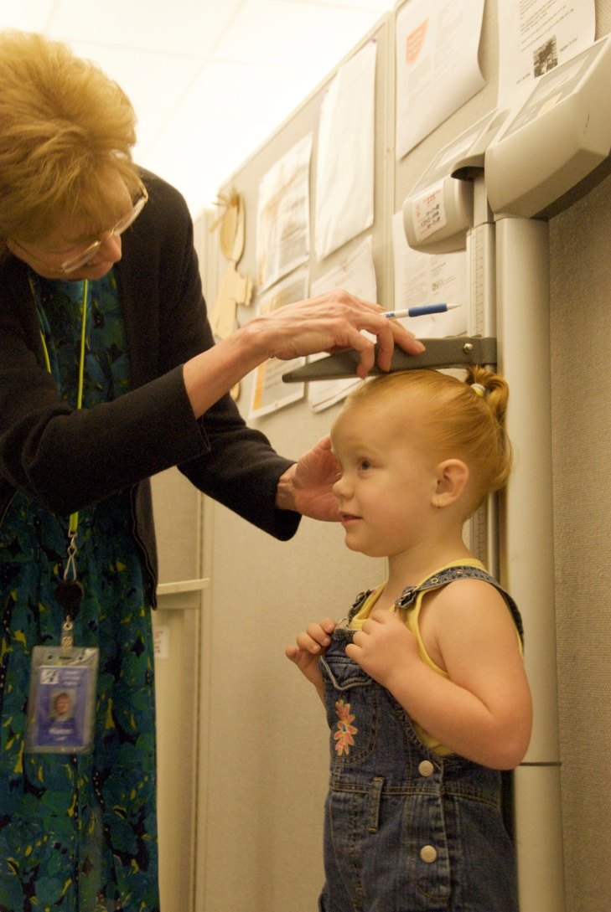
What are your questions?
How do we measure up?

